Slide 1

A ROBOTIC ARM SOLUTION FOR SMARTER WASTE MANAGEMENT

Slide 2
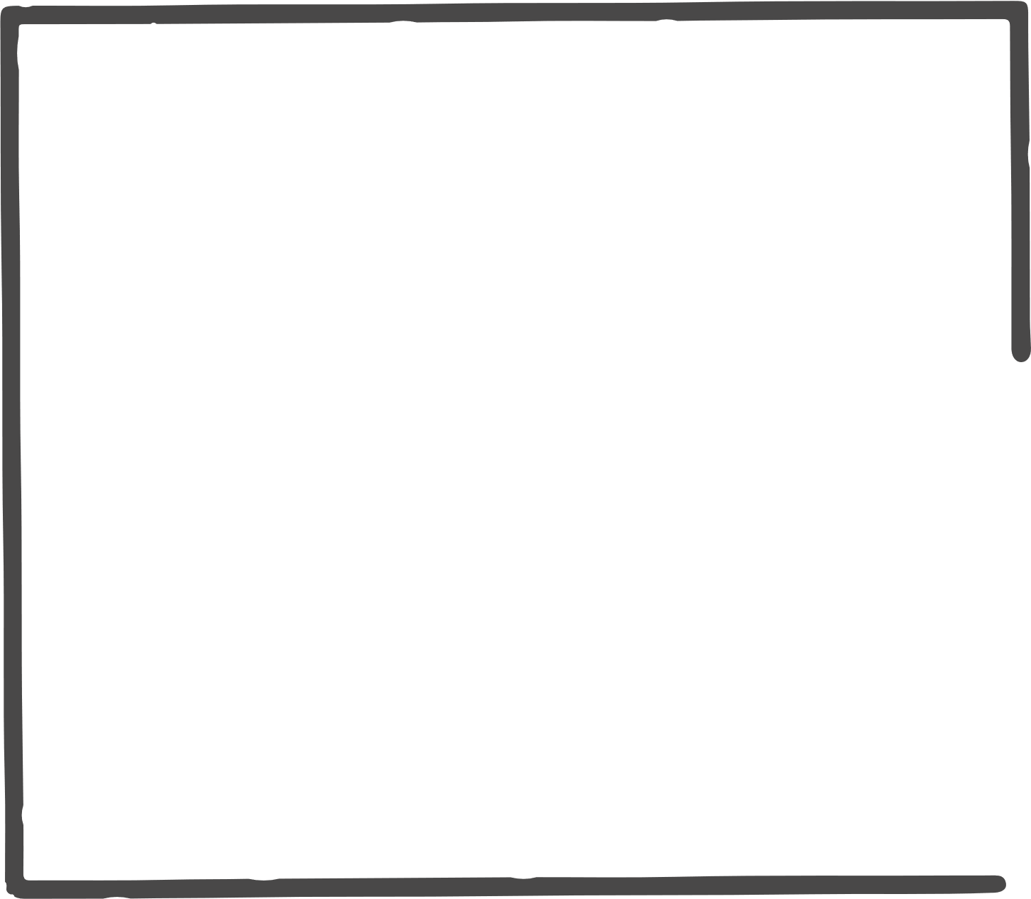
PROJECT OVERVIEW
Our Project Model is an intelligent waste segregation system that combines the power of machine learning and robotics to automate the classification and sorting of Waste. The project aims to address the inefficiencies in traditional waste handling by using an object detection model and a robotic arm to recognize and segregate waste materials such as paper, metal, and glass.

Slide 3
OBJECTIVES
To develop a real-time waste classification system using machine learning.
To build a robotic arm capable of sorting waste based on the detected class.
To provide a cost-effective solution that can be used in offices, and public places for better waste management.

Slide 4
EXISTING SYSTEM
  Manual Waste Segregation :
  Performed by humans, risky and labor-intensive.
  Slow and inefficient for large waste volumes.
  Environmental Impact :
  Growing landfills , Soil and water pollution and Impact on public health.
  Lack of Automation :
  Limited use of robotics, sensors.
  No real-time sorting or segregation capability.
  Overall ,
  Current systems do not align with smart waste management goals and Difficult to scale for urban environments.

Slide 5
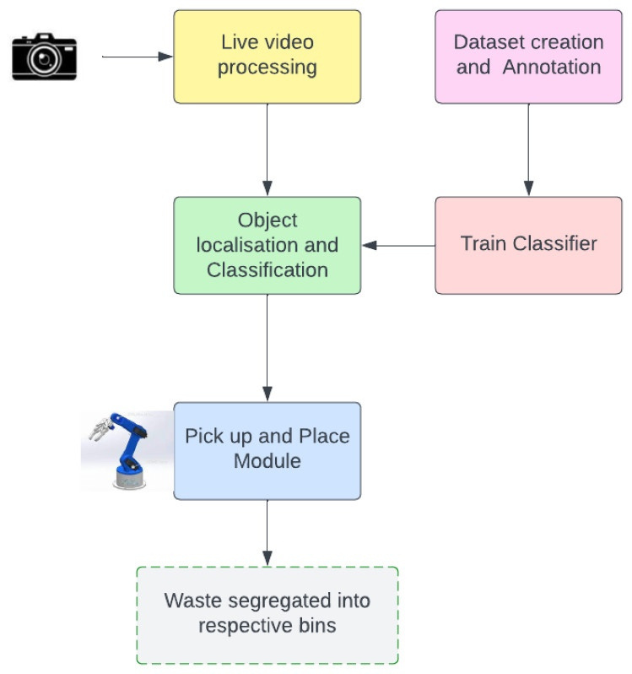
PROPOSED SYSTEM / METHODOLOGY

Slide 6
PROPOSED SYSTEM / METHODOLOGY
Methodology Steps:
1. Image Acquisition (Using Raspberry PI Camera)
2. Waste Classification (Software Module – Developed Using YOLOv8n)
3. Hardware Integration (Robotic arm + PCA-16Bit PWM Driver)
4. Robotic Arm Control (Mechanical Module – Pick and Place)

Slide 7
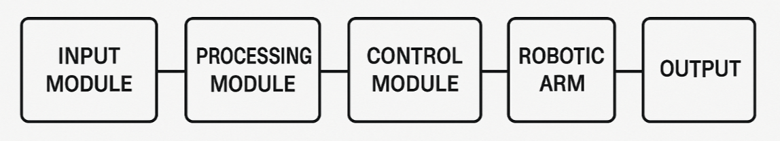
IMPLEMENTATION
Input Module: USB Camera captures real-time images of waste.
Processing Module: Machine learning model (YOLOv8n) predicts waste type.
Control Module: Output signals sent to robotic arm controller.
Robotic Arm System: Moves and places waste into the appropriate bin.
Output: Sorted waste, ready for recycling.

Slide 8
CONCLUSION
  Successfully implemented the image acquisition module for capturing waste images in real time.
  Achieved accurate recognition and classification of waste categories using machine learning.
  Implemented robotic arm control for automated waste picking and sorting.
  Developed a complete automated waste segregation system that is efficient, reliable, and suitable for smart waste management.

Slide 9
REFERENCES
Research Paper :
Ionut-Robert Badoi and Ioan Lie “Automatic Waste Segregation System,” International Symposium on Electronics and Telecommunications (ISETC),2022
Kaggle Data Sets :
https://www.kaggle.com/datasets/techsash/waste-classification-data
https://www.kaggle.com/datasets/sumn2u/garbage-classification-v2

Slide 10
THANK YOU

